Slide 1
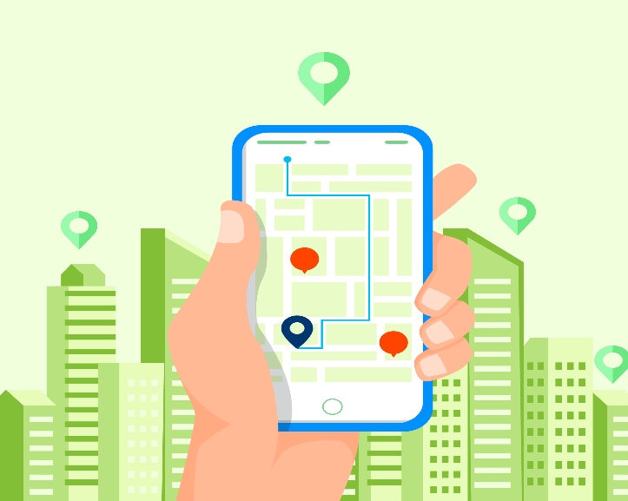

INTRODUCTION TO LOCATION BASED SERVICES
By Rahul Nandkumar (RA1911001010052)

Slide 2
WHAT IS A LOCATION BASED SERVICE?
A location based service (LBS) is a software service for mobile device applications that require knowledge about where the mobile device is geographically located.
Location-based services integrate data from various resources, including Global Positioning System (GPS) satellites, cellular tower pings and short-range positioning beacons, to provide services based on the user's geographical location.

Slide 3
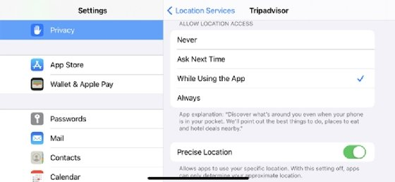
For location-based services to operate, the following four basic components are required:
An application that uses location-based services.
A positioning mechanism to collect geodata.
A mobile network to transmit or receive data.
Analytics software running on a remote server to compute and deliver relevant data to the user based on geographic location.
By law, location-based services must be permission-based, so the end user must opt in to the service in order to use it. In most cases, this means the user turns on the location-based service application and accepts a request to enable the service to know the device's location.

Slide 4
GOOGLE MAPS V2 SERVICES USING GOOGLE API
Allows your users to explore the world with rich maps provided by Google. It helps identify locations with custom markers, augments the map data with image overlays, embeds one or more maps as fragments, and much more.
Key features:
Adds maps to your app
Customizes the map
Controls the user's view
Adds Street View to your app

Slide 5
With Google Maps Android API v2, you can embed maps into an activity as a fragment with a simple XML snippet. It offer exciting features such as 3D maps; indoor, satellite, terrain, and hybrid maps; vector-based tiles for efficient caching and drawing; animated transitions; and much more.
With this API we can define custom colors or icons for your map markers to match your app's look and feel. To further enhance the app, draw polylines and polygons to indicate paths or regions, or provide complete image overlays
Provides your users with a different view of the world with the ability to control the rotation, tilt, zoom, and pan properties of the "camera" perspective of the map.

Slide 6
THANK YOU !

Slide 7
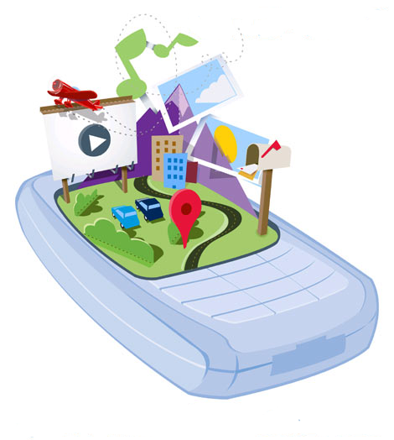
Location-Based API

Slide 8
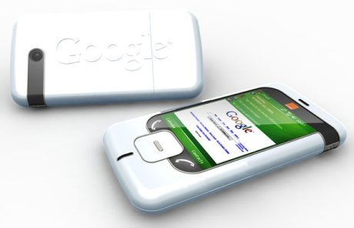
Location-Based Services
Introduction
Location-Based Services or LBS allow software to obtain the phone's current location. This includes location obtained from the Global Positioning System (GPS) satellite constellation, but it's not limited to that.
The API is considered as "optional“ API as an application can still be build without using the Location-Based API.
For example, an Android application cannot be writtien without using the Activity and Intent APIs, but an application may not need to know where the user is, so the need of the Location-Based Services API maybe not be use. In this sense, the LBS API is optional where the Activity API is not.

Slide 9
Location-Based Services
Scenarios
Location based services can be used in so many different scenarios. Such examples include :
Ride Sharing
Meet Anywhere
Social networking/Mobile Social networking
Buddy Finder/ Friend finder
location based Advertisement
location based business locator
tourism guides with text popup in different locations
Navigation
Traffic management
Car Parking guide
Mobile games
Emergency Services

Slide 10
Location-Based Services
Limitations
Geographic Limitation. Most of the current geographic search engines are only limited to USA and Canada. Some of them have a wider coverage including UK, Australia, Japan, Taiwan and few more countries. Other search engines which have not been mentioned here are (also often limited to a city or country or even to a specific language.
Data Limitation. Existing location-based engines only cover commercially collected information of local businesses e.g. those mentioned in Yellow Pages. They do not cover World Wide Web although they might have link to those pages.
Performance Limitation. An ideal geographic search and presentation has not been supported by the mentioned search engines and they can not match interactive maps with textual geographic data properly. For example, map-based query refinement is not guaranteed.
More research is needed to facilitate the extraction and assignment of addresses and locations to web resources. This geographic information is not necessarily mentioned in the web page content. As a result, more sophisticated techniques and algorithms are needed to analyze and process the web resources to make them usable in location-based search engines.

Slide 11
Location-Based Services
API Packages
The Location-Based API includes two packages android.location & com.google.android.maps that provide an initial look at the support in the Android platform for building location-based services.
Location-Based Service
android.location
com.google.android.map

Slide 12
android.location
LocationManager Class
LocationManager provides an API to determine location and bearing if the underlying device supports it. This class provides access to the system location services which allow applications to obtain periodic updates of the device's geographical location, or to fire an application-specified Intent when the device enters the proximity of a given geographical location.
The LocationManager should not be instantiated directly, but rather a handle to it should be retrieved.
The application will be able to do three things:
Query for the list of all LocationProviders known to the LocationManager for its last known location.
Register/unregister for periodic updates of current location from a LocationProvider (specified either by Criteria or name).
Register/unregister for a given Intent to be fired if the device comes within a given proximity (specified by radius in meters) of a given lat/long.

Slide 13
android.location
Location Class
Location Class
A class representing a geographic location sensed at a particular time (a "fix"). A location consists of a latitude and longitude, a UTC timestamp. and optionally information on altitude, speed, and bearing.
Information specific to a particular provider or class of providers may be communicated to the application using getExtras, which returns a Bundle of key/value pairs. Each provider will only provide those entries for which information is available. Some common keys are:
"satellites" - returns the number of satellites used to obtain the fix

Slide 14
android.location
LocationProvider & LocationProviderImpl Class
LocationProvider Class
An abstract superclass for location providers. A location provider provides periodic reports on the geographical location of the device. Each provider has a set of criteria under which it may be used; for example, some providers require GPS hardware and visibility to a number of satellites; others require the use of the cellular radio, or access to a specific carrier's network, or to the internet. They may also have different battery consumption characteristics or monetary costs to the user. The Criteria class allows providers to be selected based on user-specified criteria.
LocationProviderImpl Class
An abstract superclass for location provider implementations. Location provider implementations are typically instantiated by the location manager service in the system process, and location information is made available to implementations via the manager.

Slide 15
android.location
Address, Criteria & Geocoder Class
Address Class
A class representing an Address, i.e, a set of Strings describing a location.
Criteria Class
A class indicating the application criteria for selecting a location provider. Providers maybe ordered according to accuracy, power usage, ability to report altitude, speed, and bearing, and monetary cost.
Geocoder Class
A class for handling geocoding and reverse geocoding. Geocoding is the process of transforming a street address or other description of a location into a (latitude, longitude) coordinate. Reverse geocoding is the process of transforming a (latitude, longitude) coordinate into a (partial) address.

Slide 16
Android location APIs make it easy for you to build location-aware applications, without needing to focus on the details of the underlying location technology.
This becomes possible with the help of Google Play services, which facilitates adding location awareness to your app with automated location tracking, geofencing, and activity recognition.
This tutorial shows you how to use Location Services in your APP to get the current location, get periodic location updates, look up addresses etc.
The Location Object
The Location object represents a geographic location which can consist of a latitude, longitude, time stamp, and other information such as bearing, altitude and velocity. There are following important methods which you can use with Location object to get location specific information

Slide 17
Sr.No. | Method & Description
1 | float distanceTo(Location dest) Returns the approximate distance in meters between this location and the given location.
2 | float getAccuracy() Get the estimated accuracy of this location, in meters.
3 | double getAltitude() Get the altitude if available, in meters above sea level.
4 | float getBearing() Get the bearing, in degrees.
5 | double getLatitude() Get the latitude, in degrees.
6 | double getLongitude() Get the longitude, in degrees.
7 | float getSpeed() Get the speed if it is available, in meters/second over ground.
8 | boolean hasAccuracy() True if this location has an accuracy.
9 | boolean hasAltitude() True if this location has an altitude.
10 | boolean hasBearing() True if this location has a bearing.

Slide 18
Sr.No. | Method & Description
10 | boolean hasBearing() True if this location has a bearing.
11 | boolean hasSpeed() True if this location has a speed.
12 | void reset() Clears the contents of the location.
13 | void setAccuracy(float accuracy) Set the estimated accuracy of this location, meters.
14 | void setAltitude(double altitude) Set the altitude, in meters above sea level.
15 | void setBearing(float bearing) Set the bearing, in degrees.
16 | void setLatitude(double latitude) Set the latitude, in degrees.
17 | void setLongitude(double longitude) Set the longitude, in degrees.
18 | void setSpeed(float speed) Set the speed, in meters/second over ground.
19 | String toString() Returns a string containing a concise, human-readable description of this object.

Slide 19
Get the Current Location
To get the current location, create a location client which is LocationClient object, connect it to Location Services using connect() method, and then call its getLastLocation() method. This method returns the most recent location in the form of Location object that contains latitude and longitude coordinates and other information as explained above. To have location based functionality in your activity, you will have to implement two interfaces −
GooglePlayServicesClient.ConnectionCallbacks
GooglePlayServicesClient.OnConnectionFailedListener
These interfaces provide following important callback methods, which you need to implement in your activity class −

Slide 20
Sr.No. | Callback Methods & Description
1 | abstract void onConnected(Bundle connectionHint) This callback method is called when location service is connected to the location client successfully. You will use connect() method to connect to the location client.
2 | abstract void onDisconnected() This callback method is called when the client is disconnected. You will use disconnect() method to disconnect from the location client.
3 | abstract void onConnectionFailed(ConnectionResult result) This callback method is called when there was an error connecting the client to the service.
We should create the location client in onCreate() method of your activity class, then connect it in onStart(), so that Location Services maintains the current location while your activity is fully visible. You should disconnect the client in onStop() method, so that when your app is not visible, Location Services is not maintaining the current location. This helps in saving battery power up-to a large extent.

Slide 21
Get the Updated Location
If you are willing to have location updates, then apart from above mentioned interfaces, you will need to implement LocationListener interface as well. This interface provide following callback method, which you need to implement in your activity class −
Sr.No. | Callback Method & Description
1 | abstract void onLocationChanged(Location location) This callback method is used for receiving notifications from the LocationClient when the location has changed.

Slide 22
Location Quality of Service
The LocationRequest object is used to request a quality of service (QoS) for location updates from the LocationClient. There are following useful setter methods which you can use to handle QoS. There are equivalent getter methods available which you can check in Android official documentation.

Slide 23
Sr.No. | Method & Description
1 | setExpirationDuration(long millis) Set the duration of this request, in milliseconds.
2 | setExpirationTime(long millis) Set the request expiration time, in millisecond since boot.
3 | setFastestInterval(long millis) Explicitly set the fastest interval for location updates, in milliseconds.
4 | setInterval(long millis) Set the desired interval for active location updates, in milliseconds.
5 | setNumUpdates(int numUpdates) Set the number of location updates.
6 | setPriority(int priority) Set the priority of the request.

Slide 24
Now for example, if your application wants high accuracy location it should create a location request with setPriority(int) set to PRIORITY_HIGH_ACCURACY and setInterval(long) to 5 seconds. You can also use bigger interval and/or other priorities like PRIORITY_LOW_POWER for to request "city" level accuracy or PRIORITY_BALANCED_POWER_ACCURACY for "block" level accuracy.
Activities should strongly consider removing all location request when entering the background (for example at onPause()), or at least swap the request to a larger interval and lower quality to save power consumption.

